Slide 1
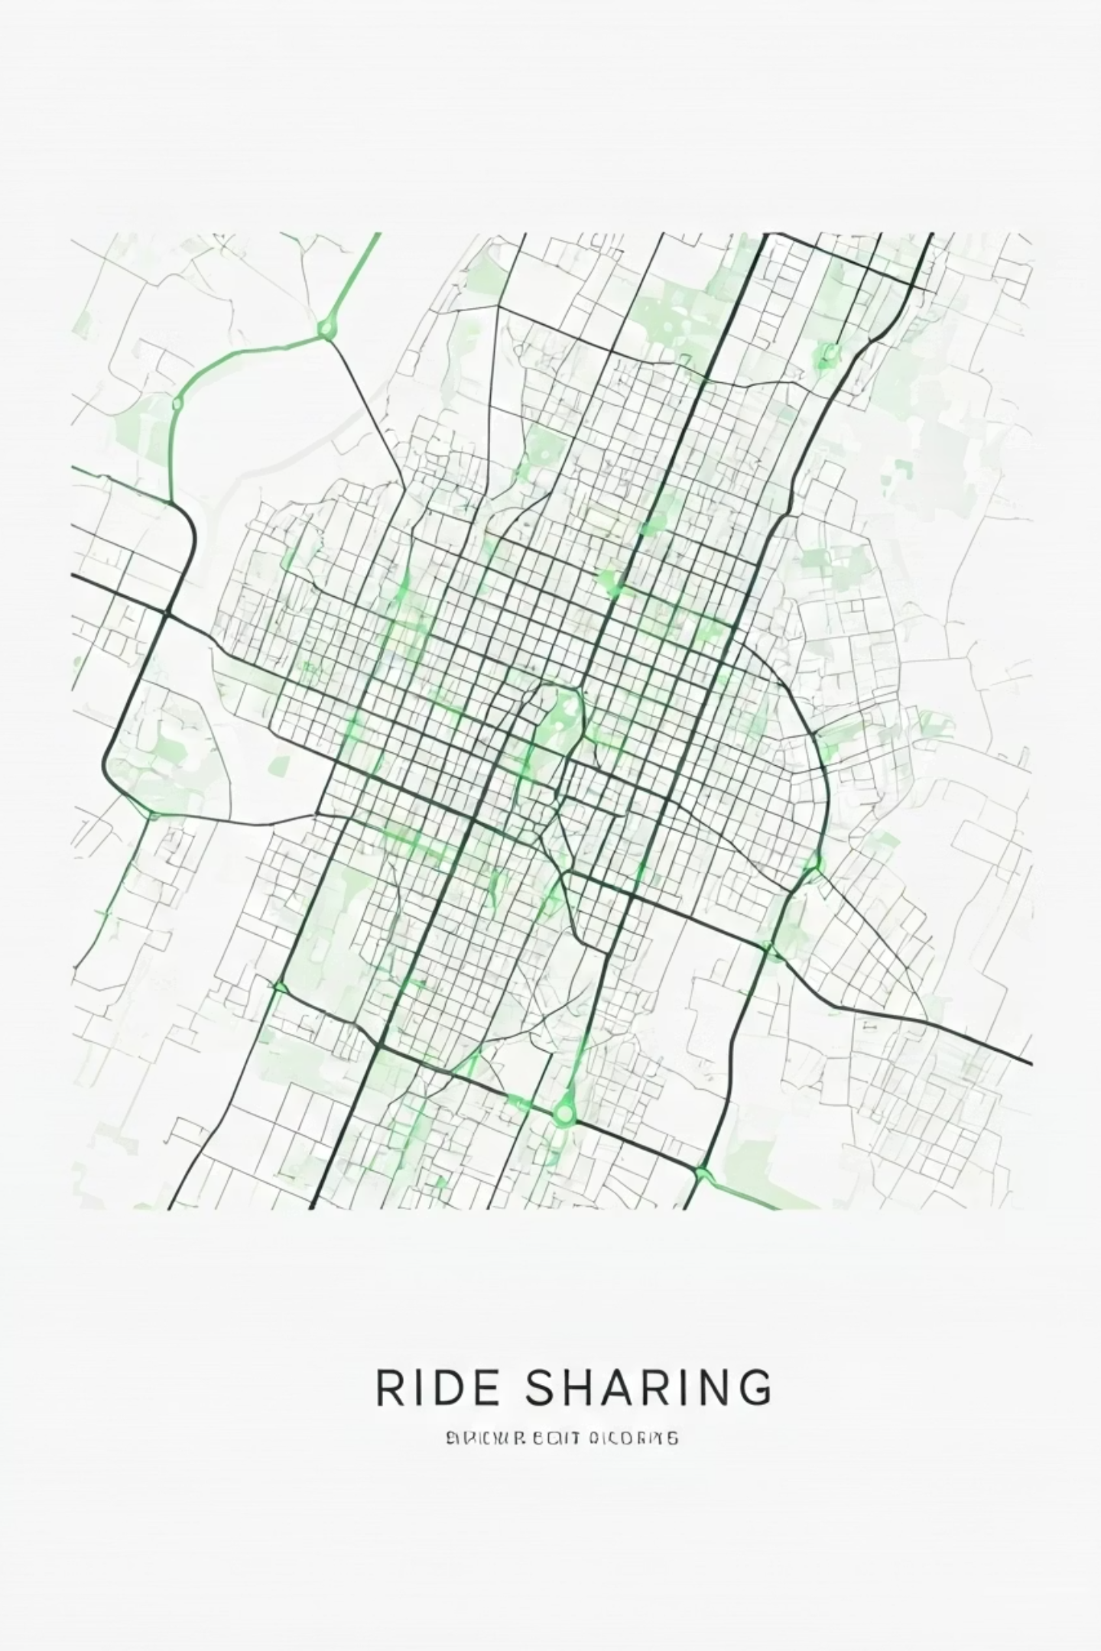
Uber Trip Analysis
PASUPULA SIVA GEETHA
3-Month Data Science Internship Project
Unified Mentor

Slide 2

Introduction: Unlocking Urban Mobility
Scope
Focus on trips recorded in the Jan–Feb dataset provided for in-depth analysis.
Objective
Approach
Analyze Uber trip data to uncover usage trends and patterns across the dataset.
Emphasize data preprocessing, trend analysis, visualization, and actionable insights.

Slide 3



The Foundation: Data Collection
Dataset Source
Uber Jan–Feb FOIL dataset
Handling Tools
Pandas for efficient data loading and manipulation.
Key Records
Trips with attributes: Date, Base Number, Active Vehicles, Total Trips.

Slide 4

Ensuring Accuracy: Data Cleaning
Null Value Check
Systematic scan for missing or null entries.
Column Validation
Verification of column names and data types for integrity.
Standardization
Removal of inconsistencies; strict standardization of date formats.

Slide 5

Refining Data: Preprocessing Steps
1
Date Conversion
Transformed date column into precise DateTime objects.
Feature Extraction
2
Derived new features:
Day
Month
Day of Week
Week Number

Slide 6
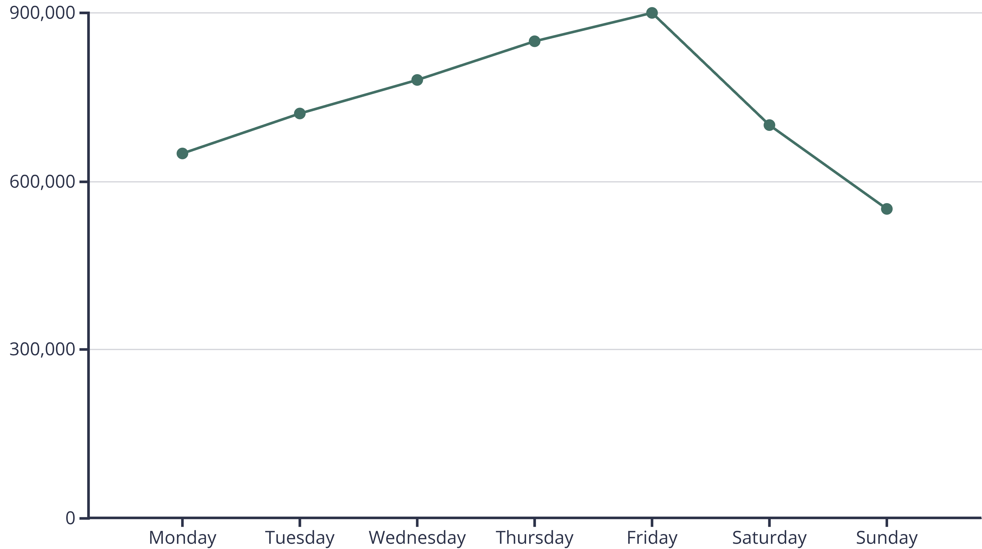
Uncovering Insights: Exploratory Data Analysis (EDA)
Distribution of trips per day, month, and week.
Vehicle activity analysis and identification of peak demand days.

Slide 7



Bringing Data to Life: Visualizations
Interactive charts and heatmaps reveal demand fluctuations and activity patterns.

Slide 8
Core Discoveries: Key Findings
Peak Demand
Highest trip demand consistently observed during weekdays.
Base Contribution
Specific dispatch centers handled the majority of total trips.
Vehicle Correlation
A direct correlation exists between vehicle availability and trip count.

Slide 9


Strategic Impact: Insights & Business Value
Optimize Resource Allocation
Identify Surge Opportunities
Insights enable Uber to deploy resources more efficiently where and when they are most needed.
Pinpointing high-demand periods allows for dynamic pricing strategies,
maximizing revenue.
These actionable insights can significantly improve operational efficiency and profitability.

Slide 10
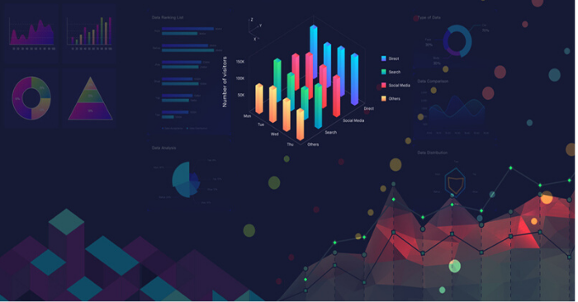
Project Conclusion: Driving Value with Data
Successfully performed data cleaning, preprocessing, analysis, and visualization of Uber trip data.
Delivered actionable insights crucial for business decision-making and strategic planning.
Tools Utilized:
Python, Pandas, NumPy, Matplotlib, Seaborn.

